Slide 1
Digital Twin Architecture
William Labasi, Jacob Labasi, Landon Jobe

Slide 2
Block Diagram

Slide 3
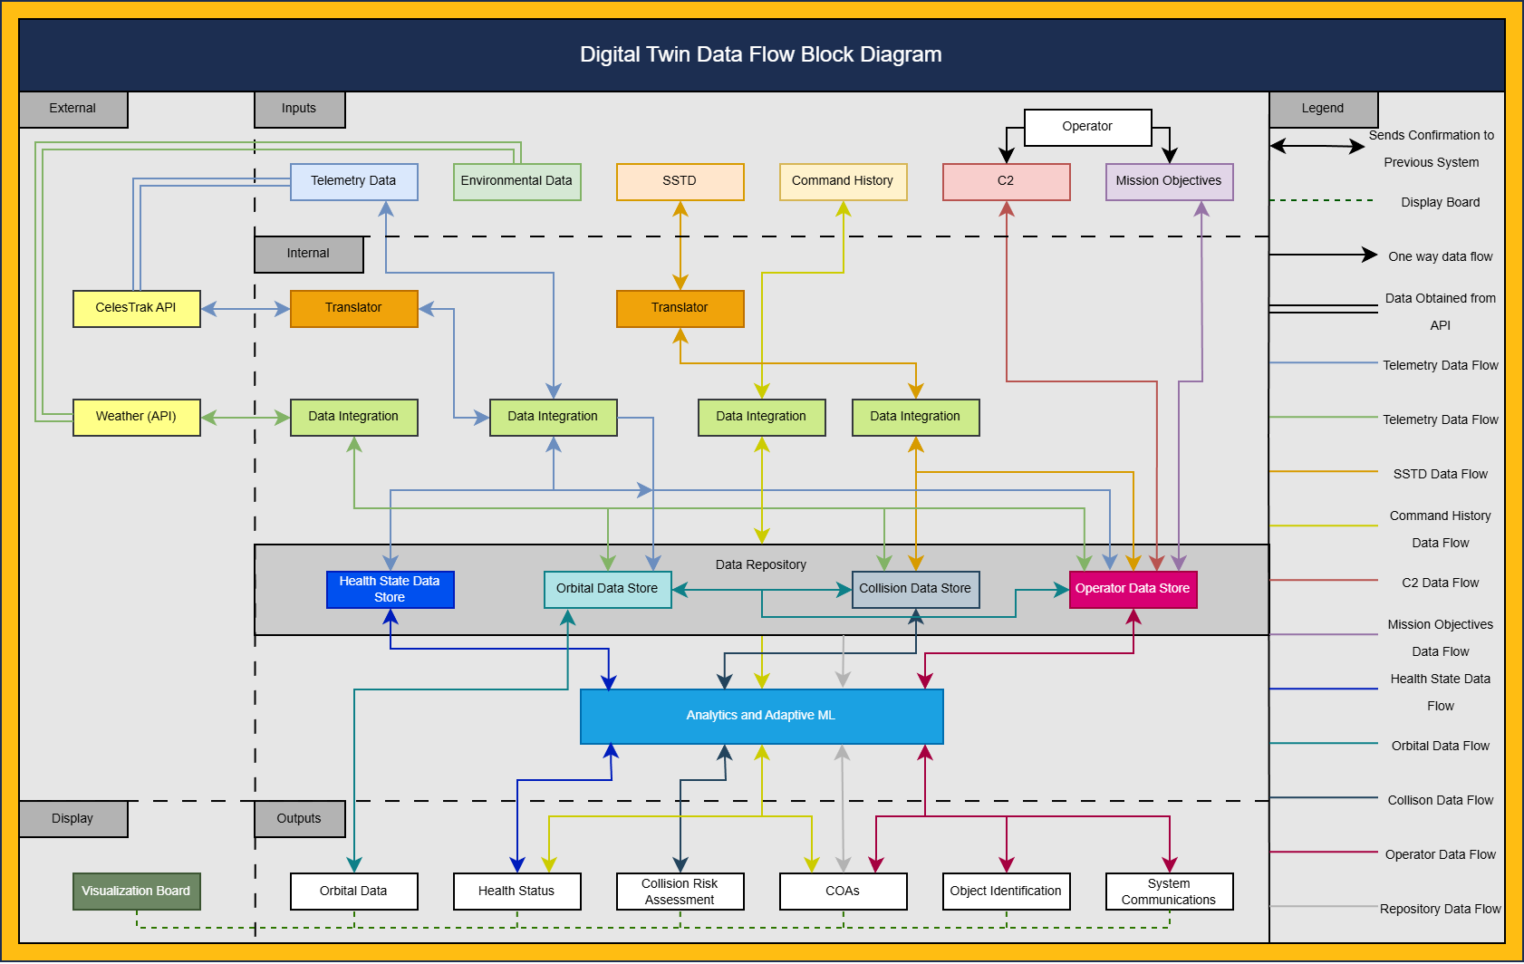
High-Level Architecture

Slide 4
Finally…

Slide 5

Dave Hansen: Rebel Hero or Imperial Scum?

